Slide 1
Year 6
Relationships and Sex Education

Slide 2
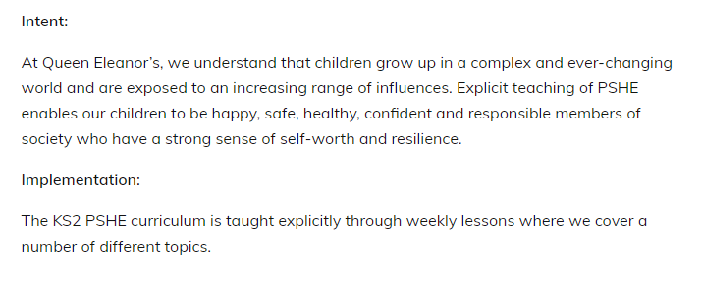

Slide 3
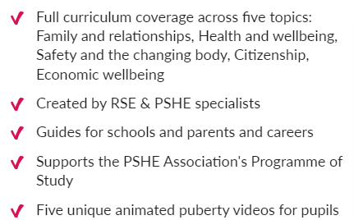
Kapow Primary
At Queen Eleanor’s, we use a scheme called ‘Kapow Primary’
It follows the National Curriculum objectives and ensures progression across all year groups

Slide 4
Progression
The slide will show the progression of learning in Key Stage 2.

Slide 6
Lesson 1
Setting ground rules for RSE:
Respecting other people’s ideas
There are no silly questions
Keeping what is said in the room, in the room
That we are all different and that is fine

Slide 7
Units being covered
Physical and emotional changes experienced during puberty
Conception
Pregnancy and birth

Slide 8
Examples of resources used: Physical and Emotional Changes at Puberty

Slide 9
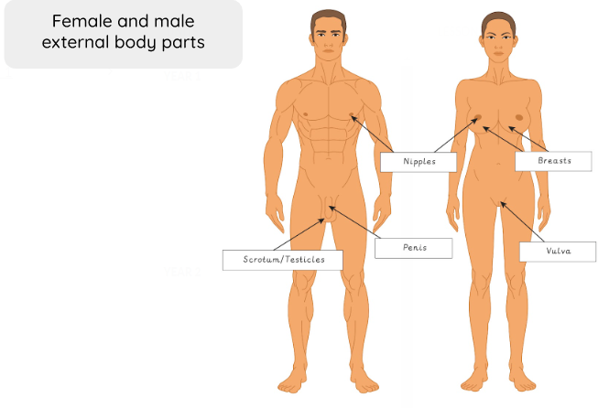
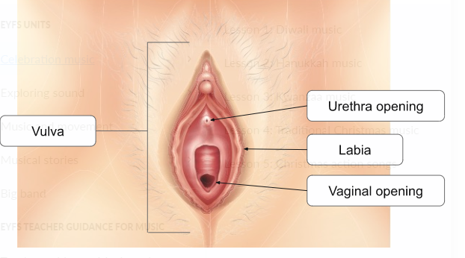
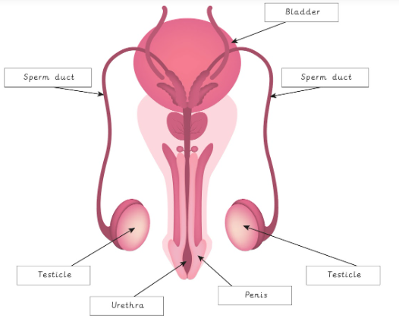

Slide 10
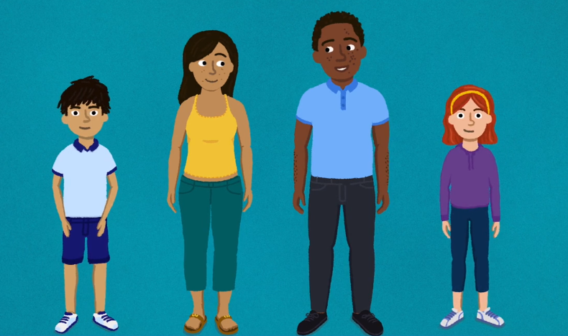
Changes at Puberty Video

Slide 11
Examples of resources used: Conception You have the right to withdraw your child from this lesson but we would strongly encourage that all children are involved in all lessons.

Slide 12
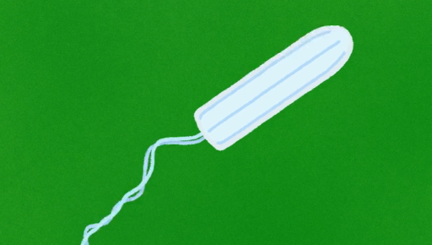
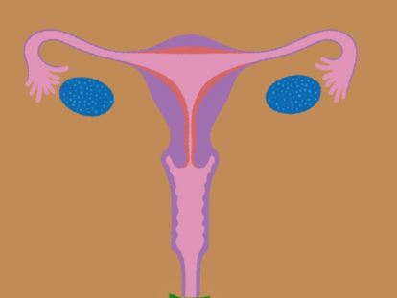
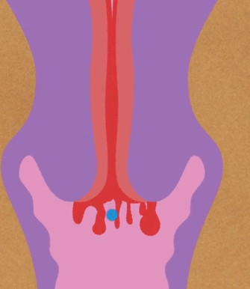
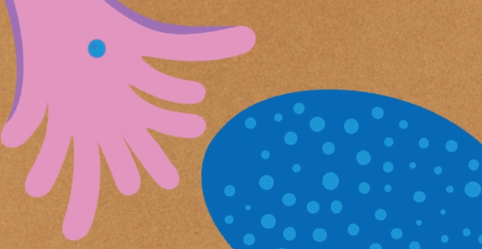
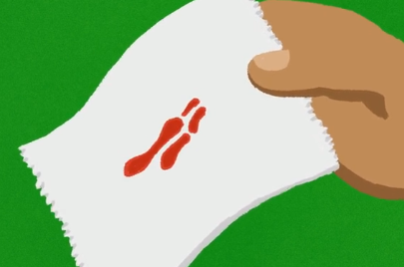
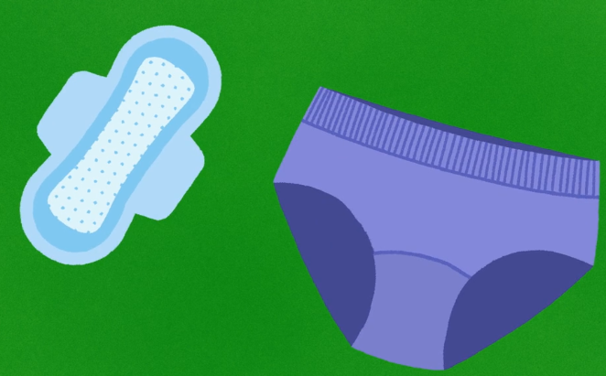
Menstruation Video

Slide 13
Menstruation Video

Slide 14
All children will learn about menstruation but girls will be given the opportunity to gather together to talk more openly and ask any questions.

Slide 15
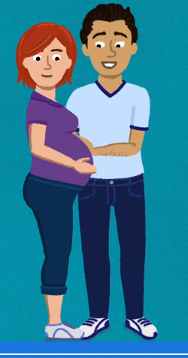
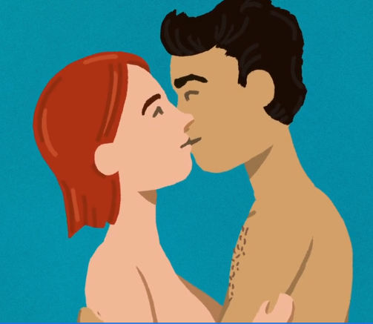
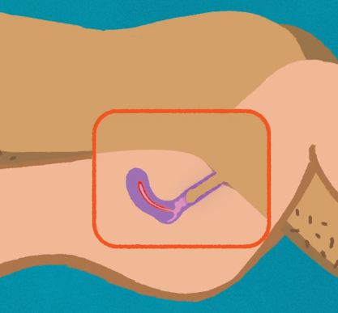
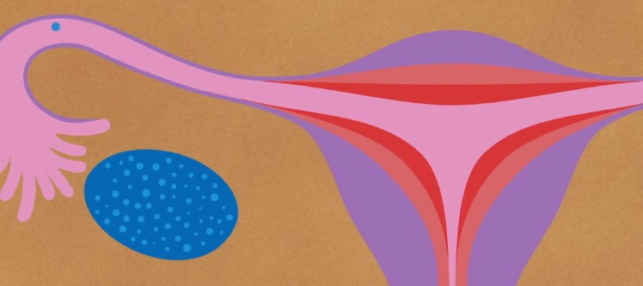
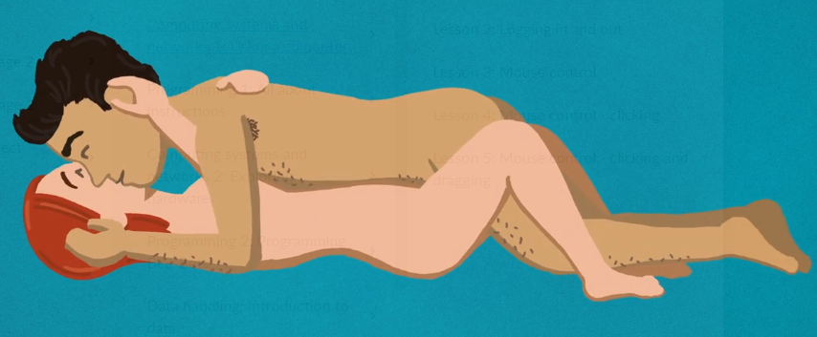
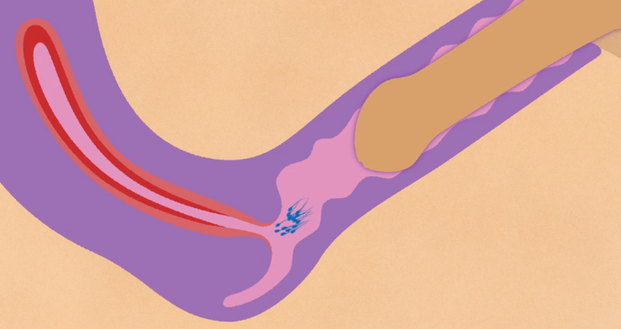
Conception Video

Slide 16
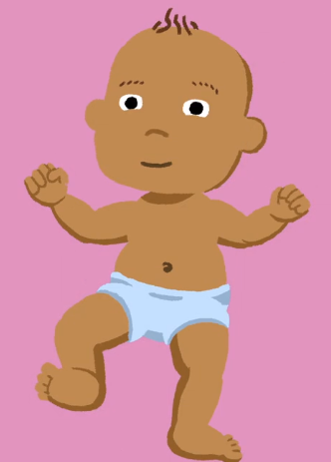
Conception Video

Slide 17
Examples of resources used: Pregnancy and Birth You have the right to withdraw your child from this lesson but we would strongly encourage that all children are involved in all lessons.

Slide 18
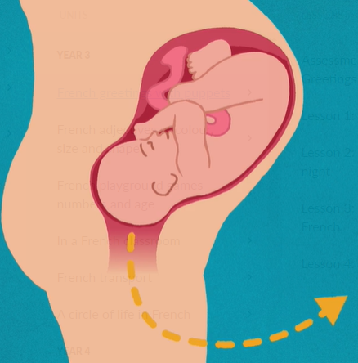
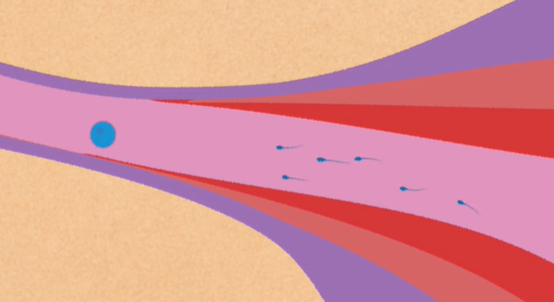
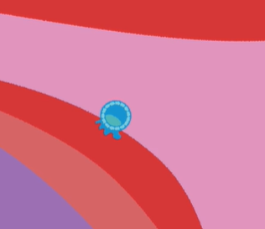
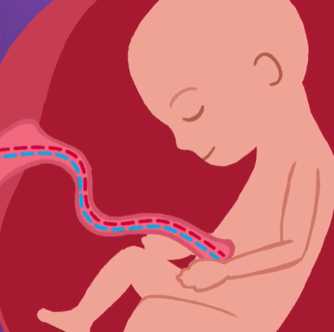
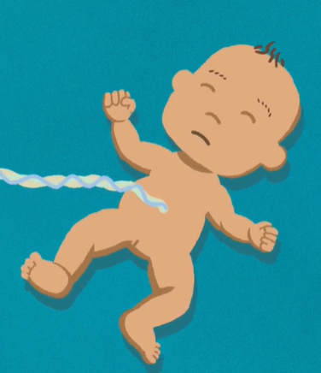
Pregnancy and Birth Video

Slide 19
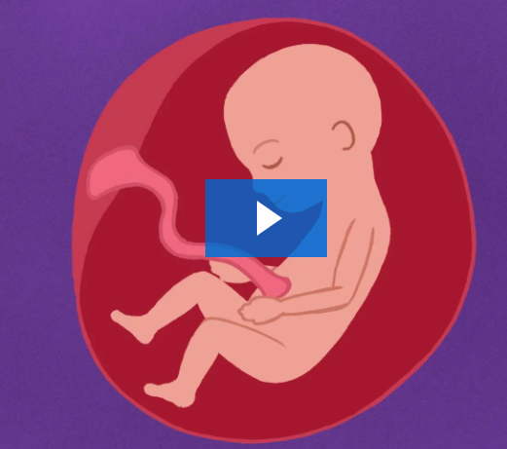
Pregnancy and Birth Video

Slide 20
If you have any questions or concerns, please contact your child’s class teacher.

