Slide 1
reading
Expectations in the new National Curriculum Tests

Slide 2
Reading – How is it assessed?
Reading is assessed in two ways: test and teacher assessment.
The Reading test
The test consists of a reading booklet containing 3 texts, and a separate answer booklet
The test will last for 1 hour which includes reading time
There will be a mixture of genres of text which may include fiction, non-fiction and poetry, although there is likely to be a greater focus on fictional texts

Slide 3
Reading – The SATs Test
The least-demanding text will come first with the following texts increasing in level of difficulty
The questions will emphasise overall understanding/comprehension of the text
Pupils can approach the test as they choose. However, to enable them to do their best at whatever confidence level they are, we prepare them by practising and encouraging them to read the first text and answer the questions on it, before moving on to the next

Slide 4
Reading – The SATs Test
We are not able to read, explain or re-phrase anything for the children in this test, other than the general instructions to ensure that they understand these
The questions are worth a total of 50 marks with some questions being awarded between 1 and 3 marks.

Slide 5
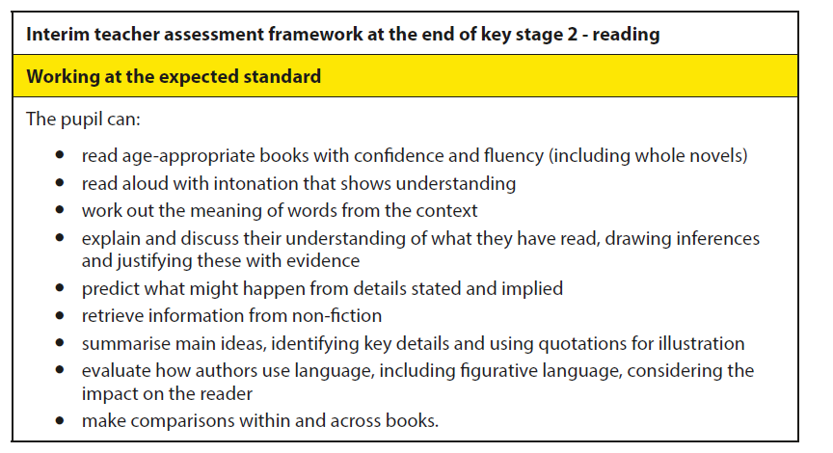
Reading
This interim document sets out the expectations for reading. Those that can be tested will be in the paper.
This document also guides our teacher assessment and can be found online.

Slide 6
Question Types
The test will cover a range of reading skills, including:
Decoding words – understanding what words mean, using the context to help them.
Comprehension – summarise, retrieve, explain and sequence information from the text.
Inference – use the clues and what they know about situations to suggest likely outcomes/actions, including predicting, and explaining characters’ thoughts, actions and feelings
Understanding the writer’s use of language to create an effect or impact the reader.
Themes and Conventions – why certain types of writing are like they are, themes or changes within a text.

Slide 7
Reading – Common Question Types
Familiarity with the types of questions and test format is important to make sure that they are able to show their best.

Slide 8
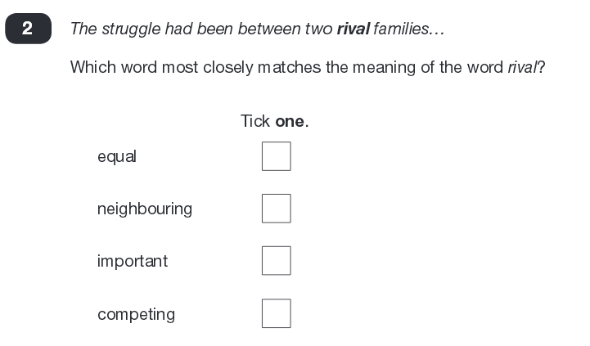
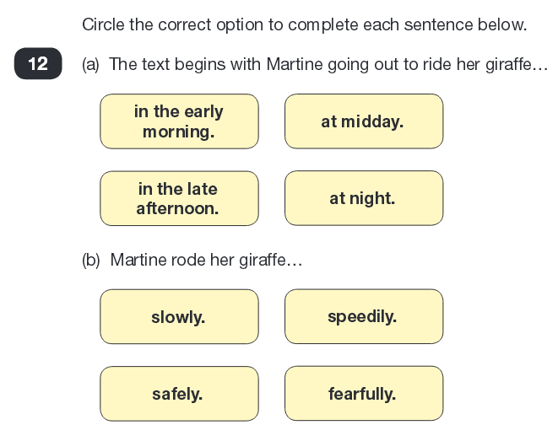
Reading – Question Examples Multiple Choice

Slide 9
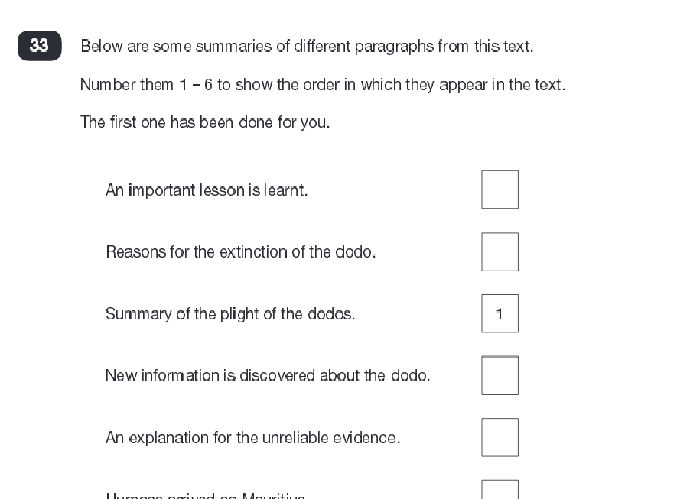
Reading – Question Examples Ranking or Ordering

Slide 10
Reading – Question Examples Matching

Slide 11
Reading – Question Examples Find and Copy

Slide 12
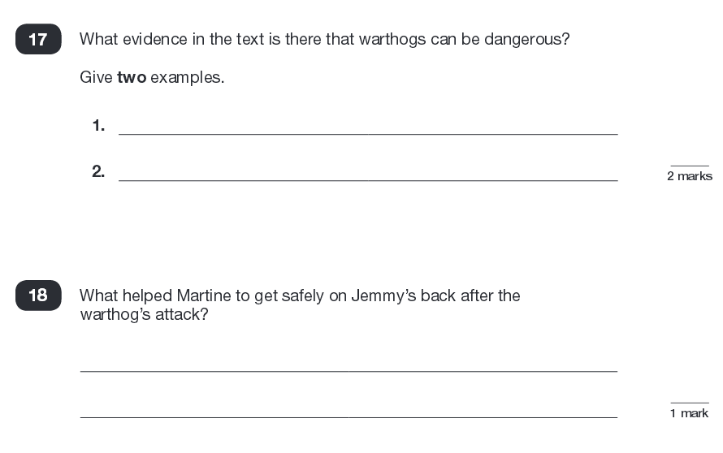
Reading – Question Examples Short Response

Slide 13
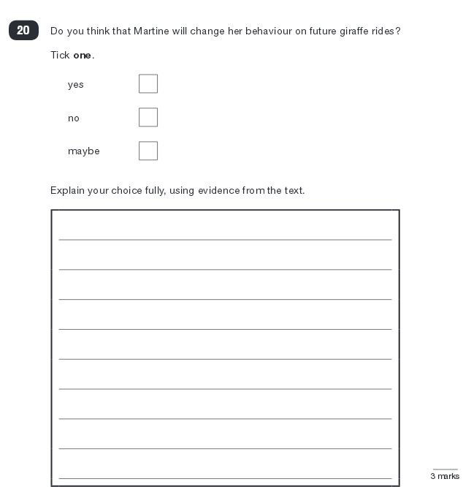
Reading – Question Examples Longer Response
These questions are worth the most marks
You are awarded marks for number of points or amount of evidence.
3 marks - 3 reasons or 2 with evidence from text.
2 marks – 2 reasons or 1 with evidence from text.
1 mark – 1 reason

Slide 14
P.E.E – Longer Answer Structure
POINT
Make the point
I think that…the character is angry
EVIDENCE
Provide the evidence
because the text says….that he shook with rage
EXPLAIN
Explain what it shows
and this shows that….he is struggling to control his temper after the argument.

Slide 15
Reading – What We Do
In school:
We use questions in a similar style and layout to those used in the test to help children understand the strategy they might use when answering them.
We encourage a range of reading and provide opportunities for children to read aloud
Children are encouraged to use reading skills and strategies across the curriculum (e.g. skim reading or scanning a text when researching in History)
VIPERS

Slide 16
Reading – Support at Home
What can parents do to help support their child?
read a range of different texts e.g. poetry, newspaper, magazine articles as well as fiction books
develop focus and speed of reading in their heads by having quiet time reading.
hear them read aloud a few times a week to ensure that they are taking account of punctuation (this will also support their awareness of and development in grammar and punctuation)
note unfamiliar words and phrases and look these up together

