Slide 1
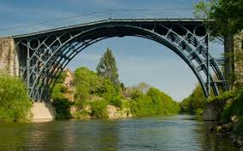
Year 4 Ironbridge Residential
2023

Slide 2
Day 1
You will arrive at school at approximately 8.30am and meet in the hall.
We aim to leave school by 9am.
We will travel by coach and make one comfort break on route. The journey takes about 3 hours.
You must wear normal clothes plus a school jumper.

Slide 3
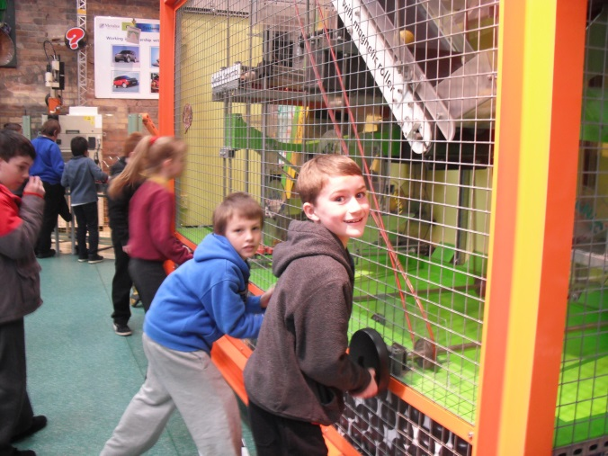
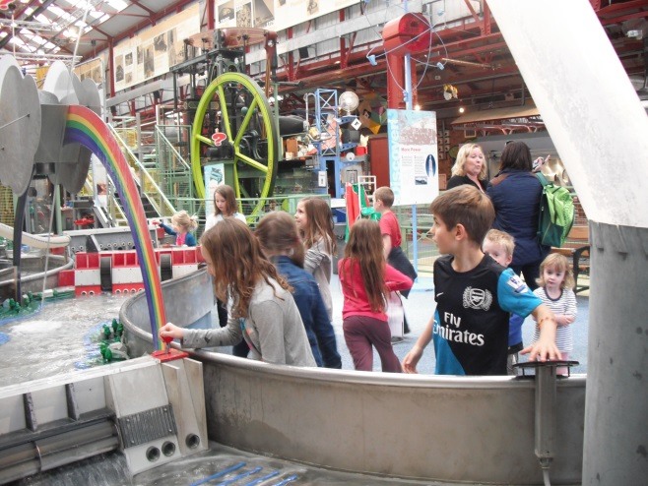
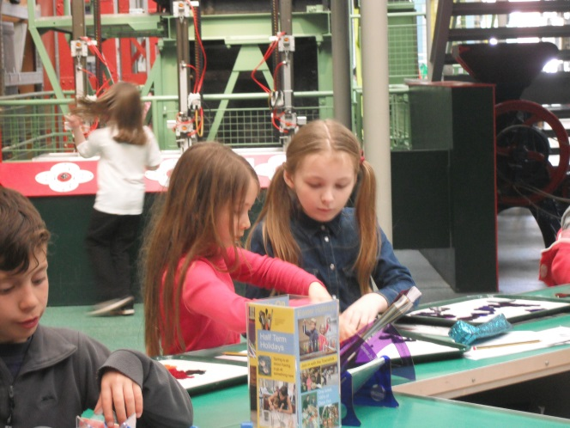
Day 1
We spend the first part of the afternoon at the Enginuity Museum. This is a hands on science museum and lots of fun!

Slide 4
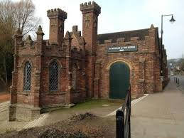
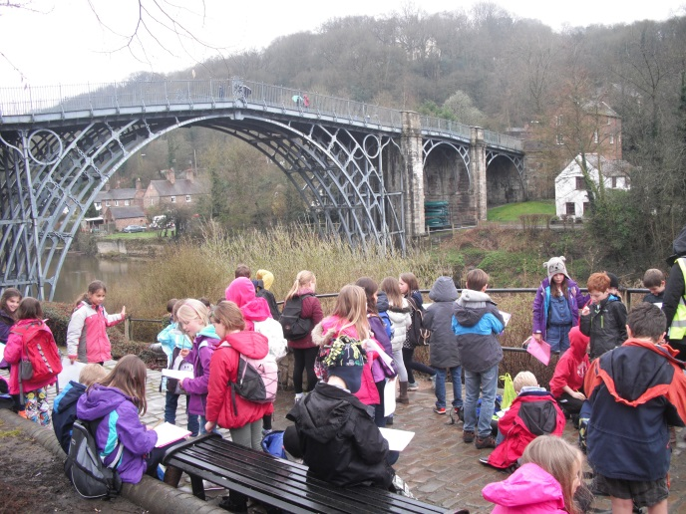
Ironbridge Gorge Museum
During the afternoon we will visit the Gorge Museum and walk up to the iron bridge itself.

Slide 5
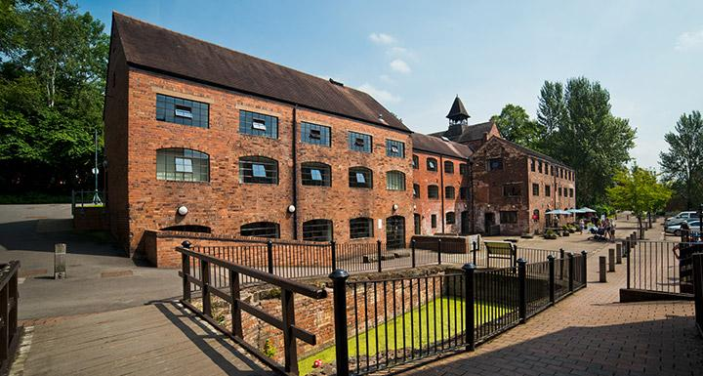
The Youth Hostel
We then go to the hostel.
Rooms of 4-8.
Rooms will be allocated on arrival.
You will have chosen you meals beforehand.
After half term, you will choose 3 names. We will ensure that you are in EITHER a day group or a bedroom with at least 1 of these children.
The evening entertainment is a quiz.

Slide 6
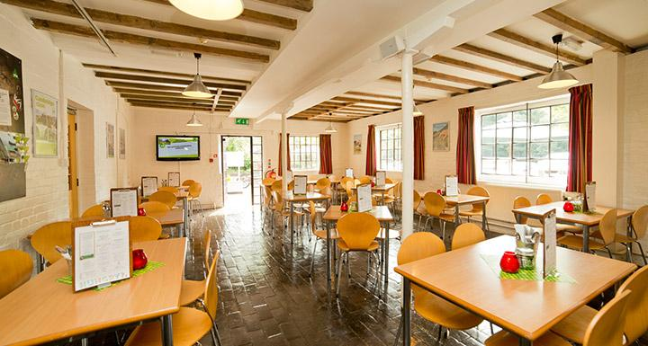
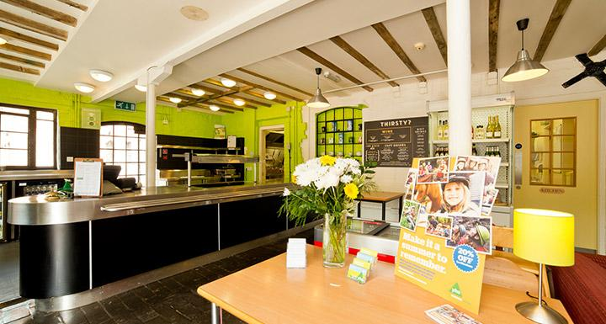
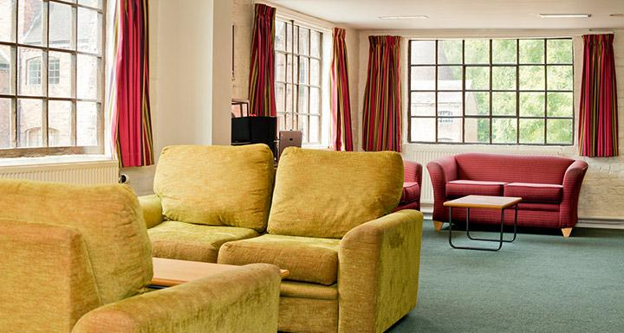
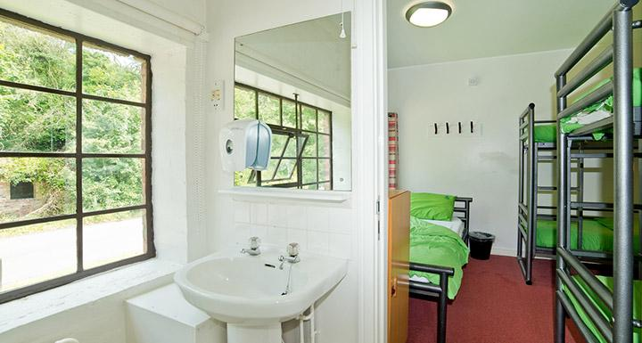
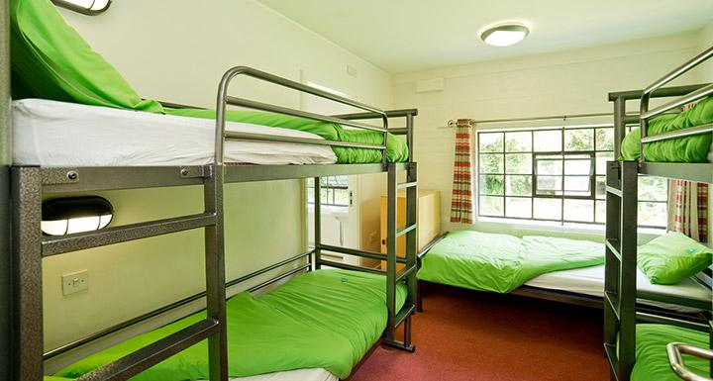

Slide 7
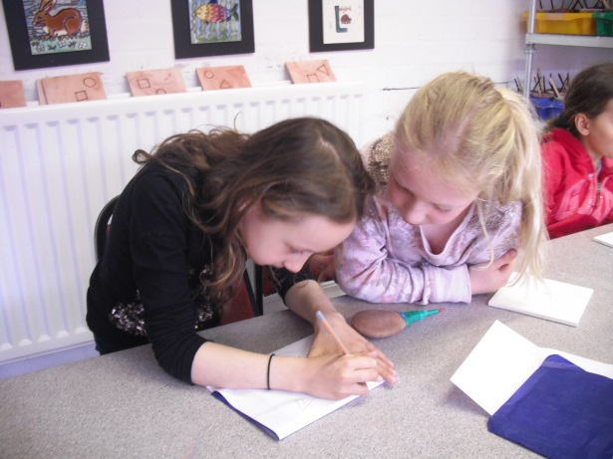
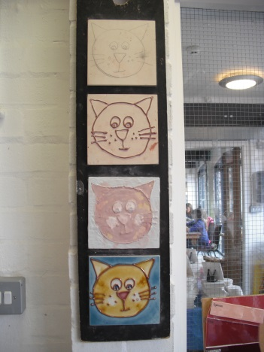
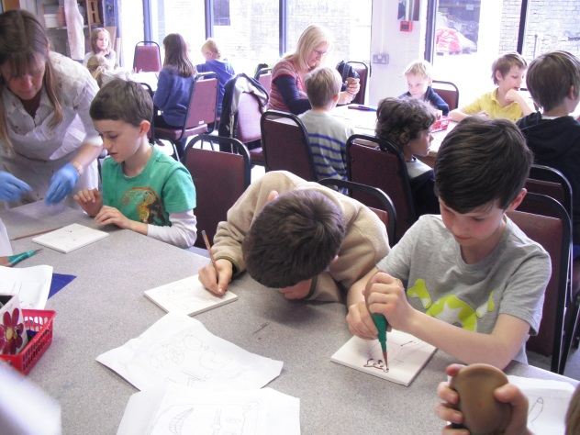
Day 2
On day 2, we will make a visit to Jackfields Tile Museum after breakfast to take part in a tile decorating workshop.
You will learn the Victorian tube lining technique to decorate their tiles, which will then be sent back to school after firing.
Then we will have a tour of the museum.

Slide 8
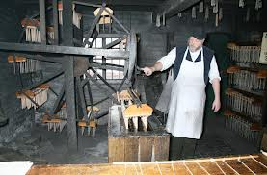
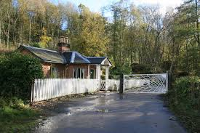
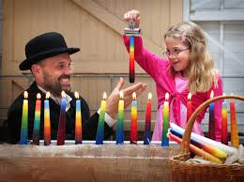
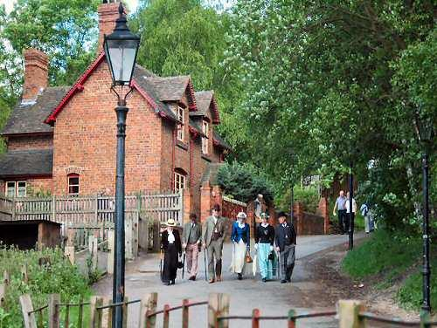
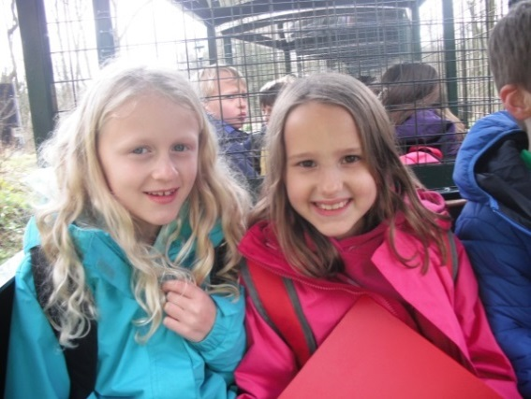
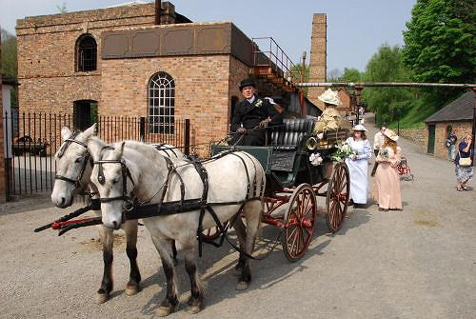
Evening activities
To end our day we will have a movie night

Slide 9
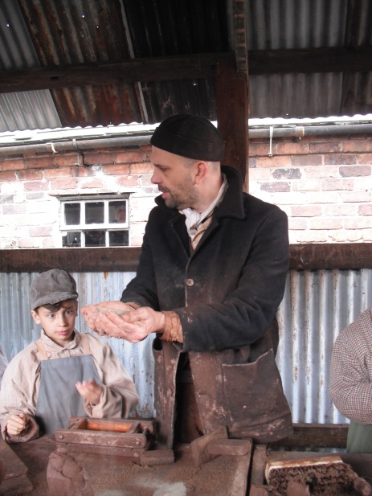
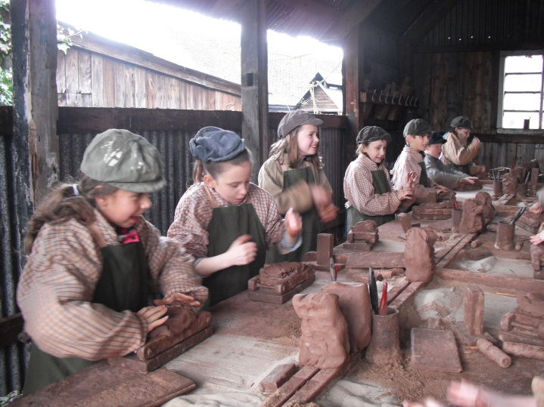
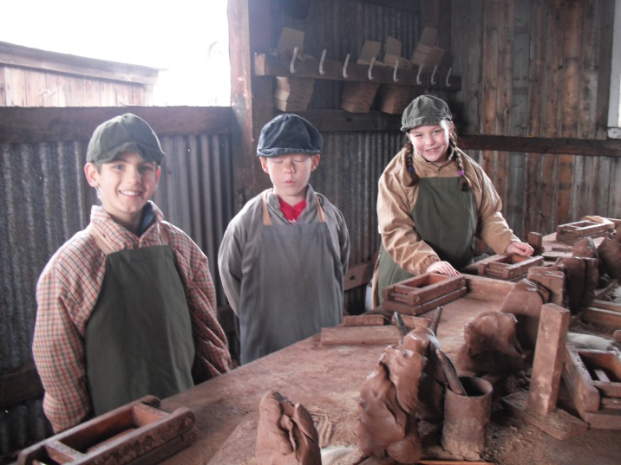
Day 3
We will go to Blists Hill to explore and take part in some activities.
We will take part in some Intaglio pattern printing.

Slide 10
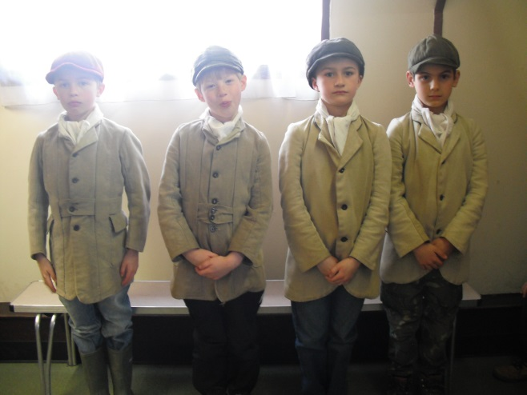
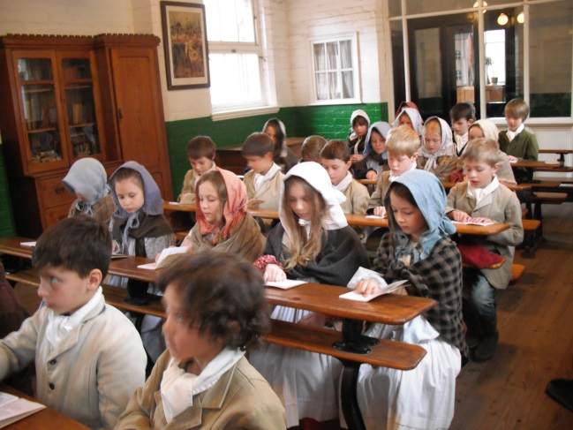
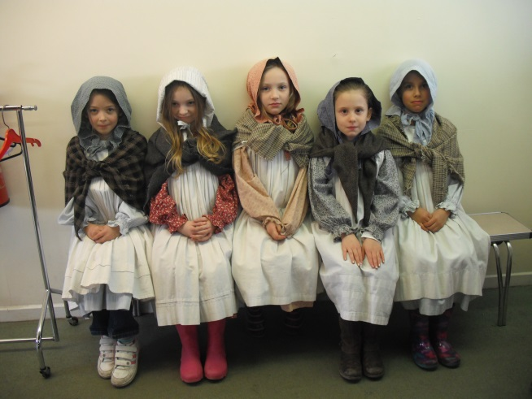
Victorian School Room
You will have the opportunity to dress up and experience a Victorian school room.

Slide 11
Talent Show!
As this will be our last evening at Ironbridge we have planned a talent show for the children.
Anyone can take part, either in groups or on their own.
You will need bring along any props they need.
This should be a fun way to spend our last evening together!

Slide 12
Day 4
Back to Blists fill for candle dipping before home.

Slide 13
Home!
Lunch will be eaten before we leave.
We aim to leave Ironbridge as close to 1.30pm as possible.
We will stop once for a comfort break and hope to be back at QE by 6pm.
We will keep school informed of our progress who will in turn keep you updated as to our estimated time of arrival.

Slide 14



Pocket Money
We suggest a maximum of £10, which needs to be in £2, £1 or 50p coins for the children to spend each day.
We ask that this gets sent into school in advance in a sealed named enveloped clearly marked with the amount.

Slide 15


Medicines
Your parents and the teachers will organise any medicine.
You must not keep any medicine on you at any time.

Slide 16
Staff
Miss Walton
Miss White
Miss Tinson
Miss Patterson
Mrs Hathrill
Mrs Wallenstein
Mrs Coling

Slide 17
Backpack for the journey:
Packed Lunch, in disposable wrappings, including drink
Snack & Water bottle (to fill each day)
Clipboard/piece of stiff card & clip
Small pencil case (Pencils, rubber, sharpener only needed)
Camera (Optional – your responsibility)

Slide 18



Clothing
A kit list will be provided in an information pack nearer the time.
The children need to be able to carry their own bags.
Please name everything!

Slide 19
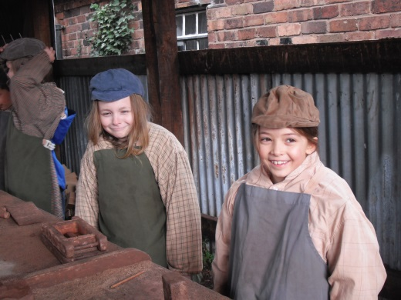
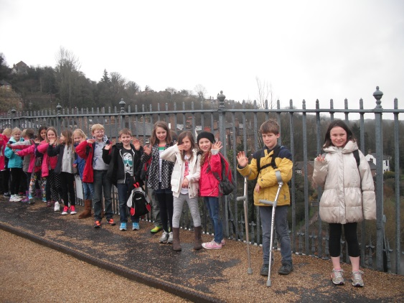
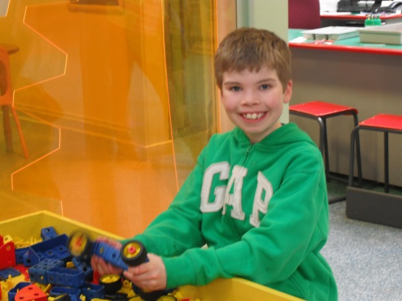
And finally!
QUESTIONS?

