Slide 1

Mastery for maths at QE

Slide 2
What mastery in maths is
How we teach maths at QE
What you can do to support your children at home
What we are going to go over today:

Slide 3
Big Curriculum revamp in 2014

Slide 4
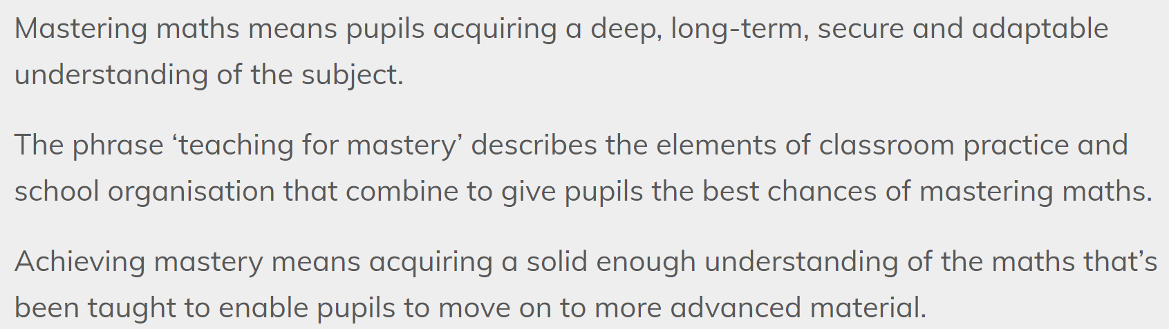
What is ‘Mastery?’

Slide 5
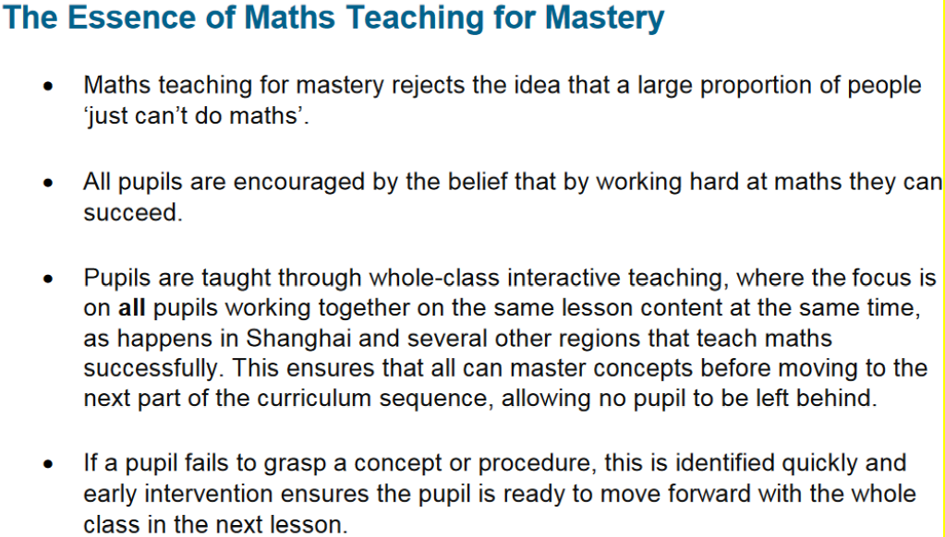
What is ‘Mastery?’

Slide 6
Children are not streamed
Children are working on the same problems together which they go through as a class
Multi-part lessons
Move away from procedural learning
How this looks at QE

Slide 7
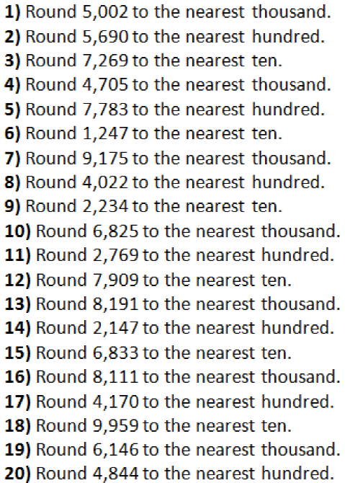
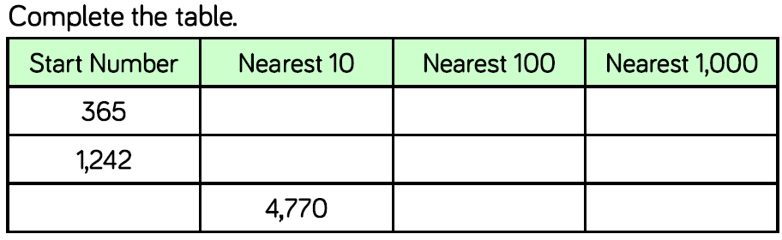
Procedural
Procedural learning vs mastery
Procedural
Mastery

Slide 8
White Rose Schemes of Learning
What we use to help us plan and teach:

Slide 9
How do we support children that find maths tricky?
How do we extend the more able mathematicians?
Key questions to consider:

Slide 10
Giving more visual representations/pictures to support
Encourage the use of manipulatives
Hints when problem solving and reasoning
Laying out the problem in a more simple way
Supporting children that find maths tricky
Support prompts

Slide 11
Support prompts
Visual representations/pictures

Slide 12
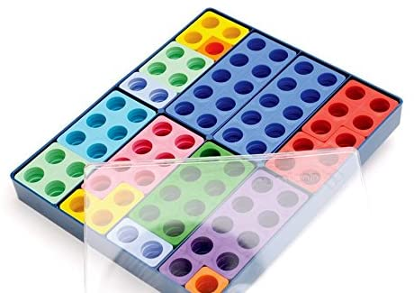
Support prompts
Encourage manipulatives

Slide 13
Support prompts
Hints when problem solving and reasoning

Slide 14
Support prompts
Laying out the problem in a more simple way

Slide 15
Show in different ways
Show using manipulatives
Encourage them to work backwards/use the inverse
Change the questions
Make their own problem/turn the question into a story (context)
Extending more able mathematicans
Extending prompts

Slide 16
Extending prompts
Laying out the problem in a more simple way

Slide 17
Extending prompts
Show using manipulatives

Slide 18
Extending prompts
Work backwards using the inverse

Slide 19
Extending prompts
Change the question

Slide 20
Extending prompts
Make your own/do as a story

Slide 21
Regularly practise/learn times tables
When completing their maths homework, get them to explain their thinking/how they know this
To extend them, get them to try a different way to solve a problem/explain their thinking
Ask them ‘what if….’ especially when problem solving
How you can support your child?

Slide 22
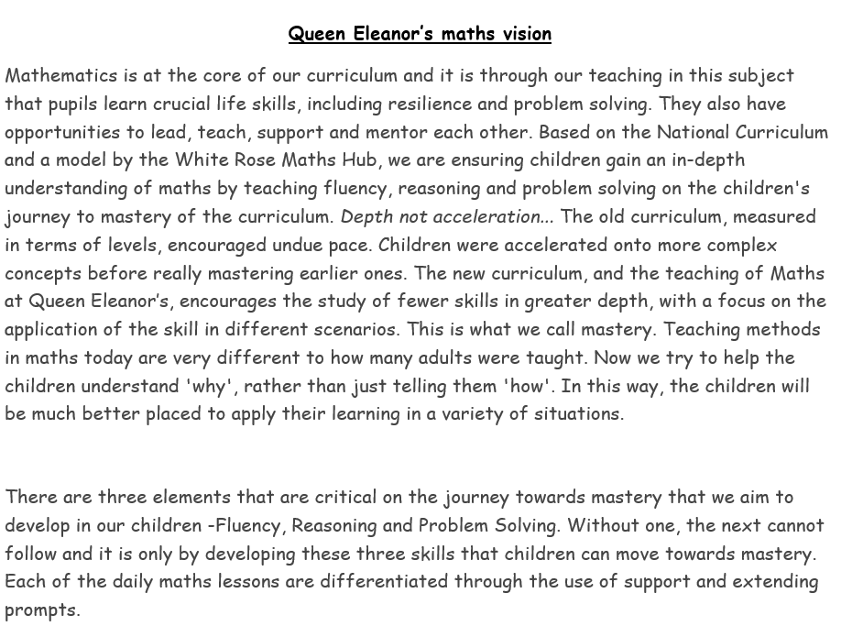
Let’s finish with QE’s vision for maths

Slide 23
NCETM website – explains mastery and gives examples of it in action
White Rose website – parent work books
If you’re interested in finding out more

Slide 24
Any questions?

